Slide 1
Mobile Cloud Computing
CHRISTIAN ANGELES
JOHN ZAVALA

Slide 2
Project Description
Our goal is to simulate computational offloading of a compute-intensive task on an android application to a cloud server.
Server will complete the task via distributed computation.
Data will be an array of at least 100,000 elements conceptualizing a large data set--data that is too large to store on an android device.
Program on the cloud server will be performing an exhaustive search and comparison to simulate the computational offloading.
In order to create a compute-intensive environment, the algorithm is going to search and compare the 100,000-element-sized array with itself. Forcing the algorithm to perform with a time complexity of O(n^2). A slower time run will allow us to see a difference in computational performance.

Slide 3
Project Environment
Amazon Web Services(AWS) EC2
Starcluster AMIs
Android OS
Linux OS
StarCluster
Message passing interface(MPI)
mpi4py for Python

Slide 4
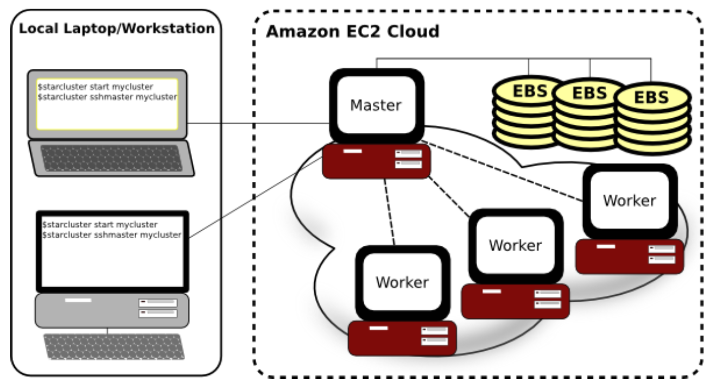
StarCluster
StarCluster- Is a tool kit that manages computer clusters hosted on Amazon’s EC2 Cloud. It is designed to automate and simplify the process of building, configuring, and managing clusters of virtual machines.
Notes:
Image from http://star.mit.edu/cluster/

Slide 5
StarCluster
Security Groups- The starcluster configures a security group for our cluster allowing us to control network access to the cluster.
Password-less SSH: The star cluster configures the cluster in order for the SSH to be used from any node within the cluster without having to login using a password.
Network File System (NFS)- able to attach Elastic Block Storage (EBS) volumes on the cluster in order to obtain persistent storage.
Within in the star cluster we can dynamically resize clusters in order to make it scalable.

Slide 6
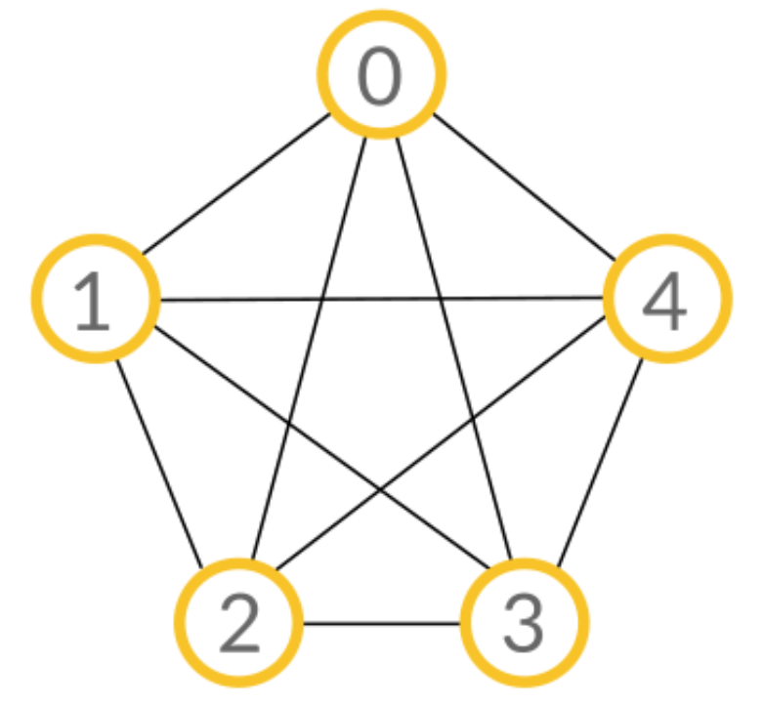
Message Passing Interface(MPI)
MPI- Standardized message passing library interface that can be used in different languages (ex. C, C++, python).
MPI is good for high performance computing and parallelism because it handles the passing of messages between different processes.
Distributed computing- Takes a single task and distributes it among computers in order to complete a task.
Point to point communications- MPI uses point to point communications to communicate from one process to another.
Blocking/Non-blocking communication
Race conditions

Slide 7
Message Passing Interface(MPI)
Collective communication- There are two types: Broadcasting and Scattering/Gathering.
Broadcasting: One process broadcasts the same information to every process.
Notes:
Image/GIF from https://www.codingame.com/playgrounds/349

Slide 8
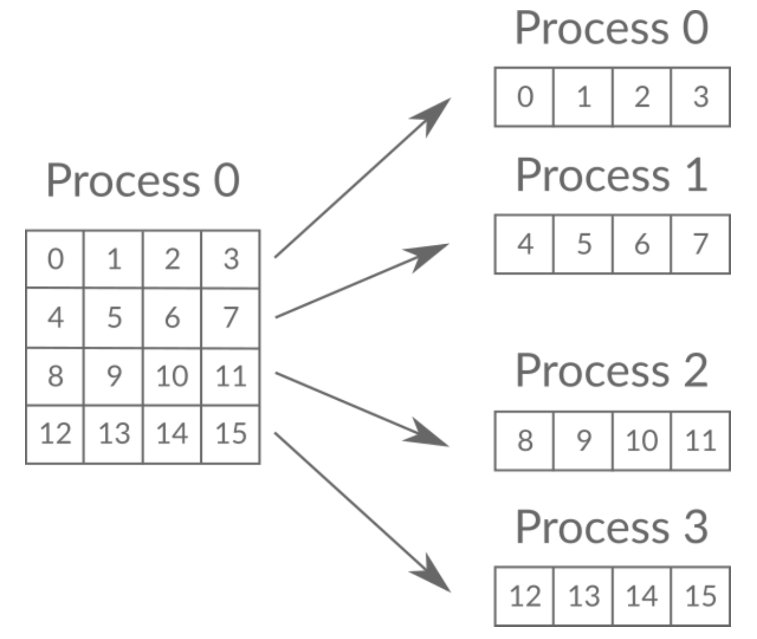
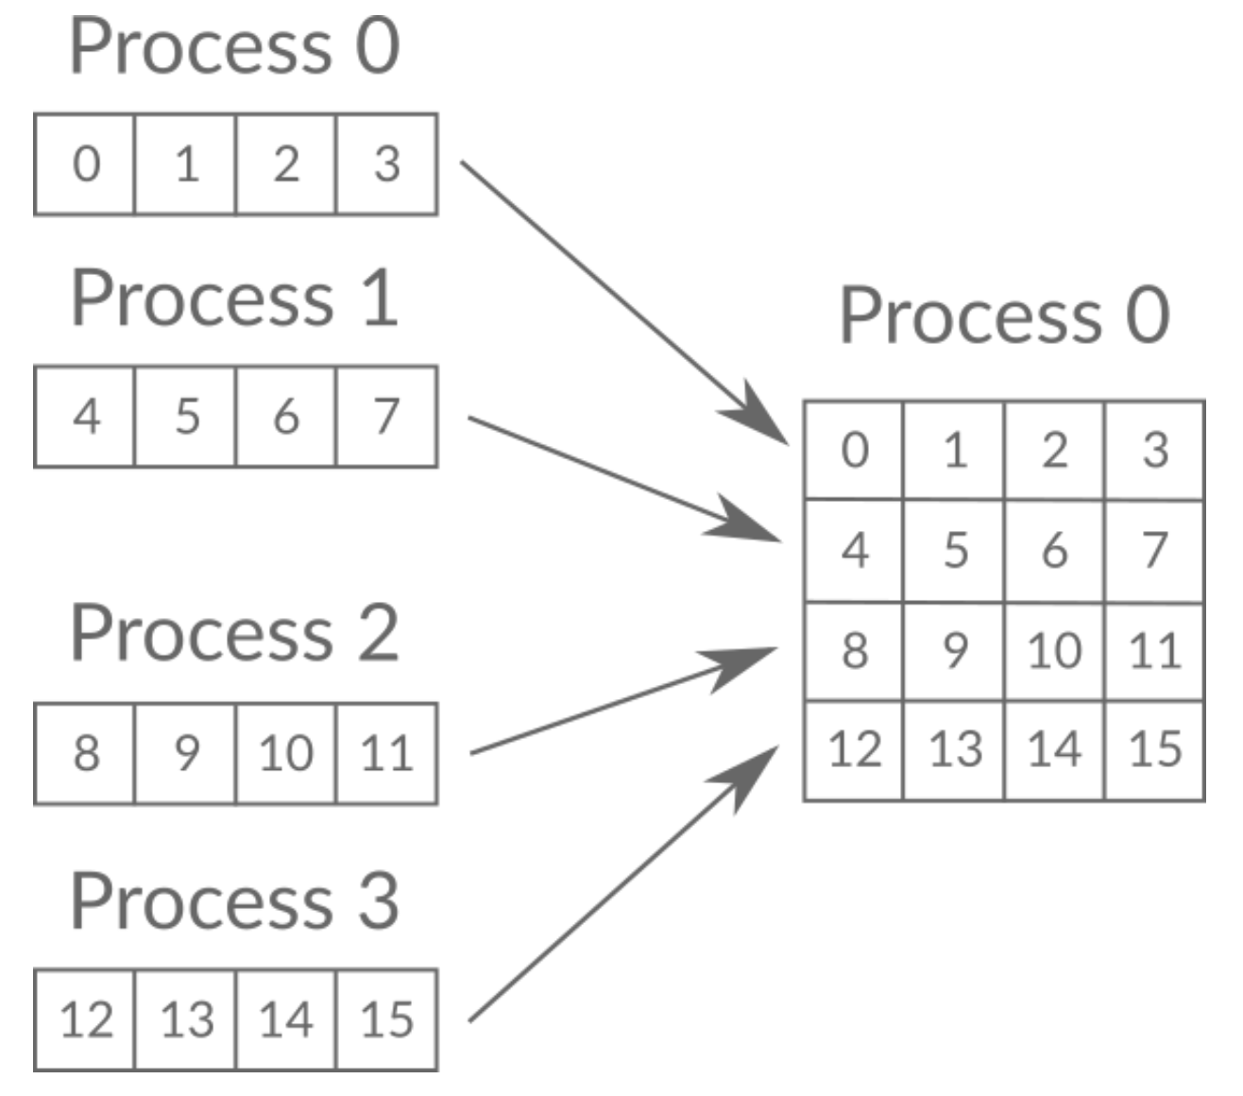
Message Passing Interface(MPI)
Collective communication- There are two types: Broadcasting and Scattering/Gathering.
Scattering/ Gathering: Are used in order to distribute and gather data.
Notes:
Image/GIF from https://www.codingame.com/playgrounds/349

Slide 9
Demonstration

Slide 10
To be continued...
Still a work in progress we need to create the android application
User interface
Have communication between application and cloud server
Socket programming (Java/Python)
Testing/Debugging

Slide 11
References
StarCluster
http://star.mit.edu/cluster
Distributed computing with MPI
https://www.codingame.com/playgrounds/349
Open MPI
https://www.open-mpi.org
mpi4py
https://mpi4py.readthedocs.io

Slide 12
Questions?

